Slide 1
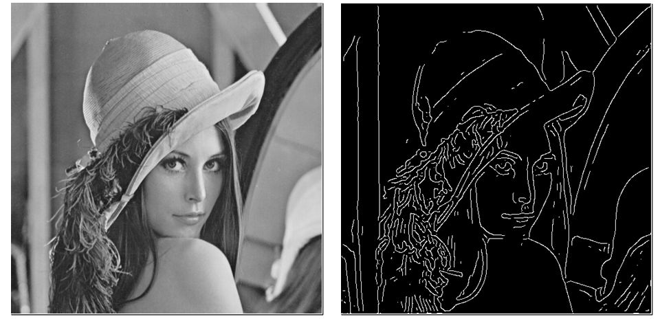

Edge detection
Yoni Chechik
www.AIisMath.com

Slide 2
References
http://szeliski.org/Book/
http://www.cs.cornell.edu/courses/cs5670/2019sp/lectures/lectures.html
http://www.cs.cmu.edu/~16385/

Slide 3
Contents
Intro to edges
Basic edge image
Edge thinning
LoG
NMS
Edge mask
Canny edge detector
Other edge related topics
Frequency representation
Unsharp filter

Slide 4
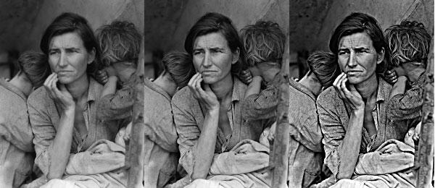
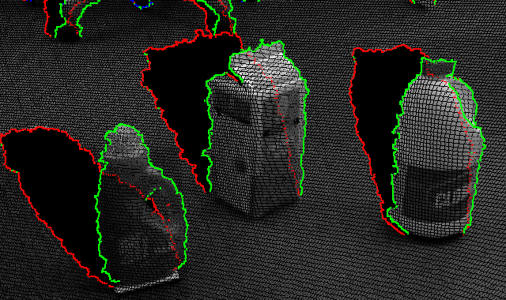
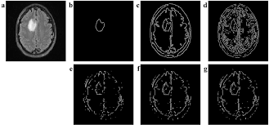
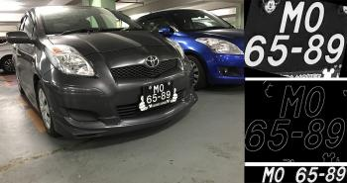
Some motivation
Art
(Instagram filters)
Robotics
(scene understanding)
Medicine
(tumor detection)
Autonomous vehicles
(license plate detection)

Slide 5

Why edges?
Representation of objects can be done without full image representation- more compact.
Edges are salient features (salient- “most noticeable or important”).

Slide 6
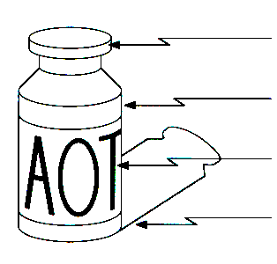
What are edges?
“The outside limit of an object, area, or surface; a place or part farthest away from the center of something.”
Edges can be caused from many reasons in images:
surface normal discontinuity
depth discontinuity
surface color discontinuity
illumination discontinuity

Slide 7
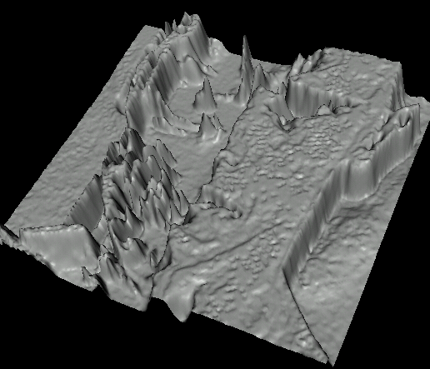
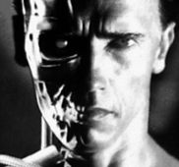
Representation in images
Rapid changes in colors.
Looks like steep edges if represented as a surface:

Slide 8
Contents
Intro to edges
Basic edge image
Edge thinning
LoG
NMS
Edge mask
Canny edge detector
Other edge related topics
Frequency representation
Unsharp filter

Slide 9
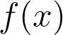
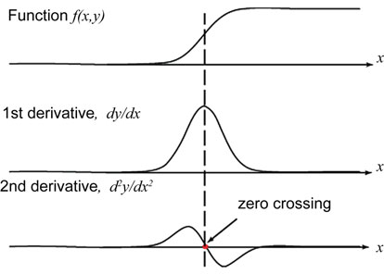
How to find edge image?
Wanted result: image of a binary mask of where there is an edge.
How to do so?

Slide 10
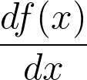
First order derivative
Derivative of an edge:
Finding maximum points in the derivative of an image is a possible way to find edges!

Slide 11
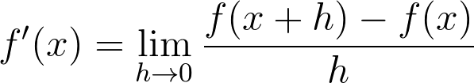
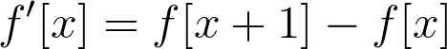
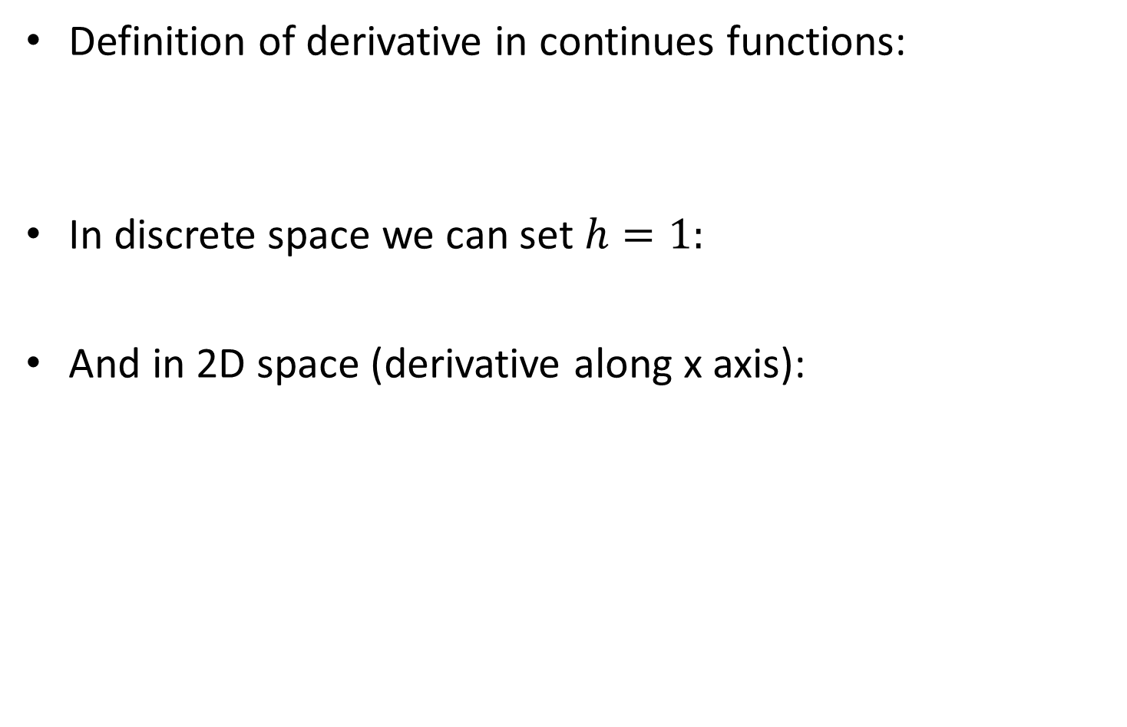
Deriving the derivative
Definition of derivative in continues functions:
In discrete space we can set $h=1:$
And in 2D space (derivative along x axis):
Notes:
f’(x)=\lim_{h\to 0}\frac{f(x+h)-f(x)}{h}
f’[x]=f[x+1]-f[x]
f'_{x}[x,y]=f[x+1,y]-f[x,y]

Slide 12
Deriving the derivative
Definition of derivative in continues functions:
In discrete space we can set $h=1:$
And in 2D space (derivative along x axis):
Notes:
f’(x)=\lim_{h\to 0}\frac{f(x+h)-f(x)}{h}
f’[x]=f[x+1]-f[x]
f'_{x}[x,y]=f[x+1,y]-f[x,y]

Slide 13
Deriving the derivative
Definition of derivative in continues functions:
In discrete space we can set $h=1:$
And in 2D space (derivative along x axis):
Notes:
f’(x)=\lim_{h\to 0}\frac{f(x+h)-f(x)}{h}
f’[x]=f[x+1]-f[x]
f'_{x}[x,y]=f[x+1,y]-f[x,y]

Slide 14
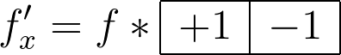
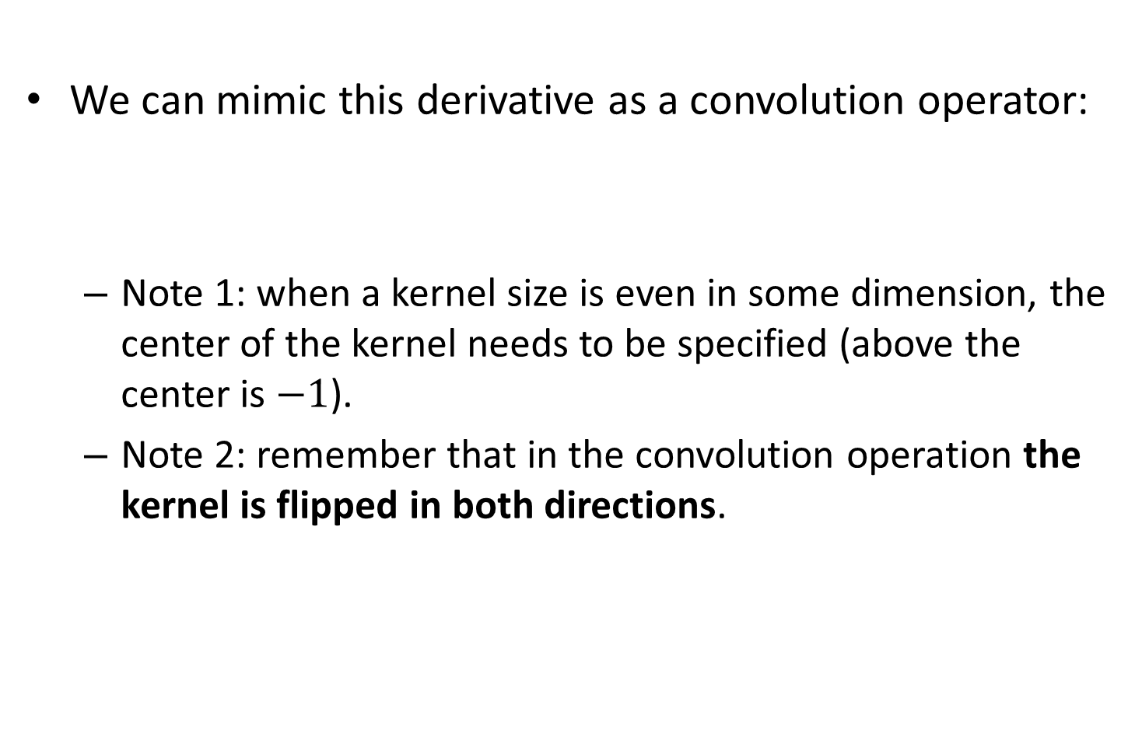
1st derivative filter
We can mimic this derivative as a convolution operator:
Note 1: when a kernel size is even in some dimension, the center of the kernel needs to be specified (above the center is $−1$).
Note 2: remember that in the convolution operation the kernel is flipped in both directions.
Notes:
f_x'=
f*\begin{array}{|c|c|}
\hline
+1 & -1 \\
\hline
\end{array}

Slide 15
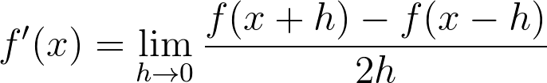
Symmetric 1st derivative
A more common approach is using the symmetric 1st derivative:
How it’s written in a discrete form?
Notes:
f'(x)=\lim_{h\to 0}\frac{f(x+h)-f(x-h)}{2h}
f_x'=
f*\frac{1}{2}\begin{array}{|c|c|c|}
\hline
+1 & \; 0 \; & -1 \\
\hline
\end{array}

Slide 16
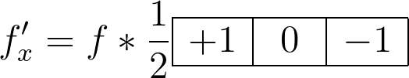
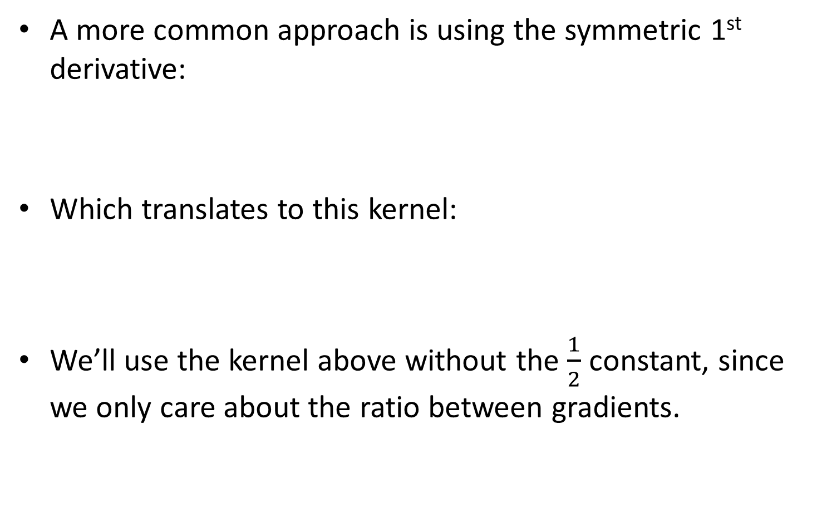
Symmetric 1st derivative
A more common approach is using the symmetric 1st derivative:
Which translates to this kernel:
We’ll use the kernel above without the $\frac{1}{2}$ constant, since we only care about the ratio between gradients.
Notes:
f'(x)=\lim_{h\to 0}\frac{f(x+h)-f(x-h)}{2h}
f_x'=
f*\frac{1}{2}\begin{array}{|c|c|c|}
\hline
+1 & \; 0 \; & -1 \\
\hline
\end{array}

Slide 17
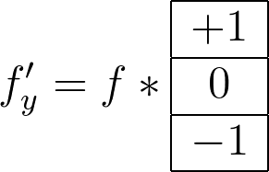
Y direction
The convolution kernel above is true for python/matlab/opencv image axis convention, where the positive y direction is down.
Let’s use this convention in the below derivation.

Slide 18

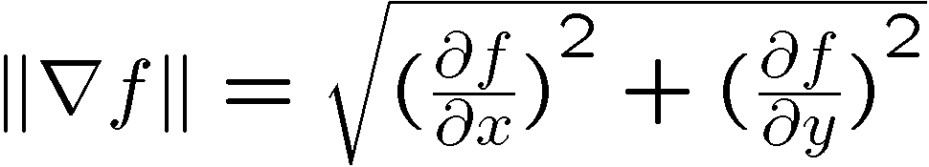
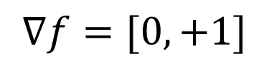
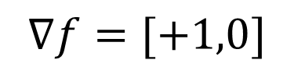
Image gradient
The gradient of an image:
The gradient points in the direction of most rapid increase in intensity:
The edge strength is given by the gradient magnitude:
$$∇f=[+1,0]$$
$$∇f=[0,+1]$$

Slide 19
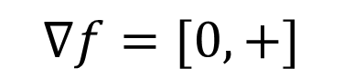
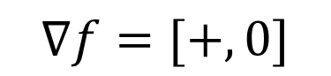
Image gradient
The gradient of an image:
The gradient points in the direction of most rapid increase in intensity:
The edge strength is given by the gradient magnitude:
The gradient of an image:
The gradient points in the direction of most rapid increase in intensity:
The edge strength is given by the gradient magnitude:
$$∇f=[+,0]$$
$$∇f=[0,+]$$

Slide 20
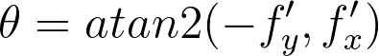
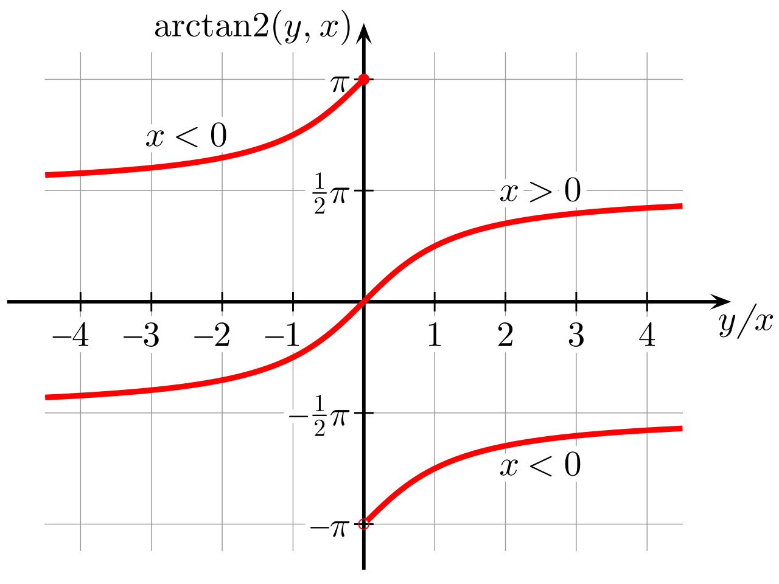
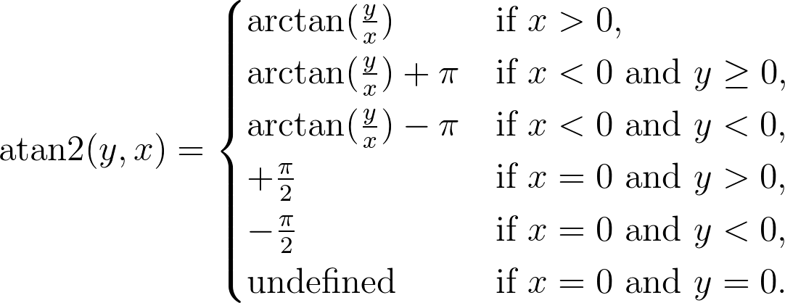
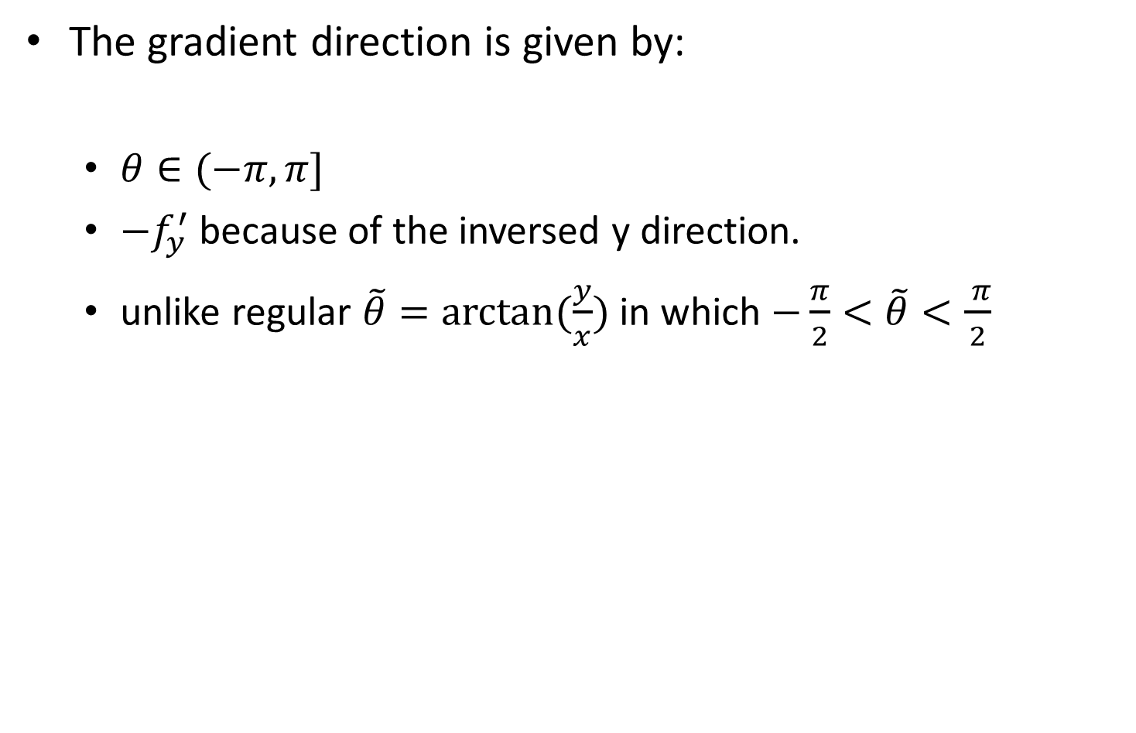
Gradient direction
The gradient direction is given by:
$θ∈(−π,π]$
$−f_{y}^{′}$ because of the inversed y direction.
unlike regular $\tilde{θ}=arctan⁡(\frac{y}{x})$in which $−\frac{π}{2}<\tilde{θ}<\frac{ π}{2}$
Notes:
\theta = atan2(-f'_y,f'_x)
\operatorname{atan2}(y,x) =
\begin{cases}
\arctan(\frac y x) &\text{if } x > 0, \\
\arctan(\frac y x) + \pi &\text{if } x < 0 \text{ and } y \ge 0, \\
\arctan(\frac y x) - \pi &\text{if } x < 0 \text{ and } y < 0, \\
+\frac{\pi}{2} &\text{if } x = 0 \text{ and } y > 0, \\
-\frac{\pi}{2} &\text{if } x = 0 \text{ and } y < 0, \\
\text{undefined} &\text{if } x = 0 \text{ and } y = 0.
\end{cases}

Slide 21



Image gradient example
Original image
$$|\left|∇f\right||$$
$$∇f_{x}$$
$$∇f_{y}$$

Slide 22

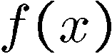
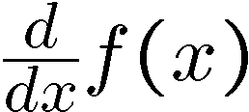
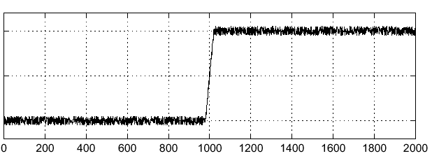
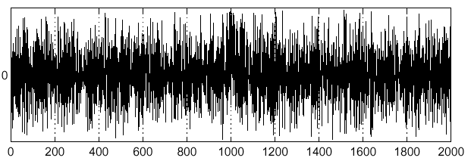
Noise effects
How to find maximum of derivative in noisy environment?
Noisy input image

Slide 23
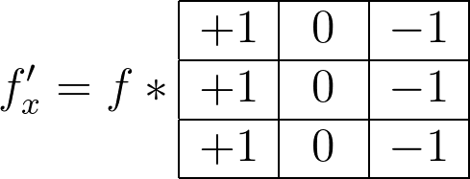
Solution 1: Prewitt filter
The same as before but more robust to noise since it uses the diagonal neighbors as well (as a kind of directional mean).
Notes:
f_x'=
f*\begin{array}{|c|c|c|}
\hline
+1 & \; 0 \; & -1 \\
\hline
+1 & \; 0 \; & -1 \\
\hline
+1 & \; 0 \; & -1 \\
\hline
\end{array}

Slide 24
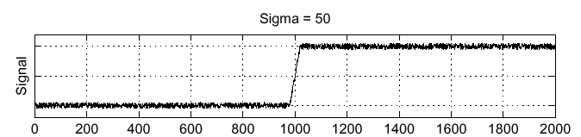
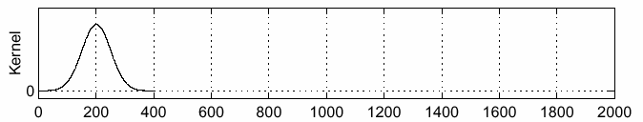
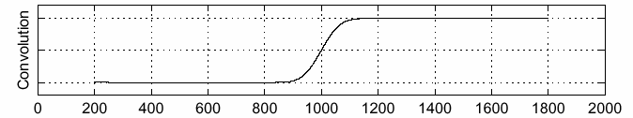
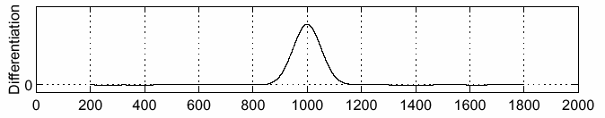
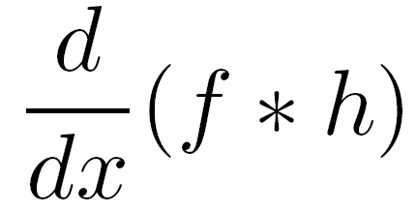
Solution 2: smoothing the noise
Search for the maximum in the smooth image!
f
h
f * h

Slide 25
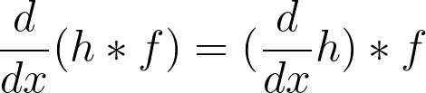
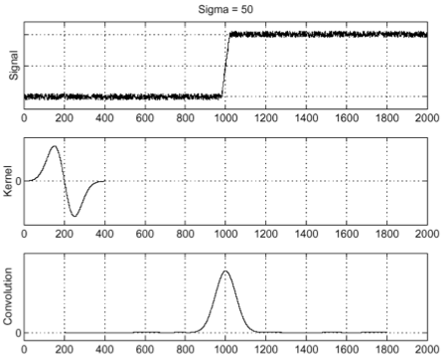
Gaussian derivative kernel
Using this convolution trick:
input
derivative of Gaussian
output (same as before)
Notes:
\frac{d}{dx}(h*f)=(\frac{d}{dx}h)*f

Slide 26
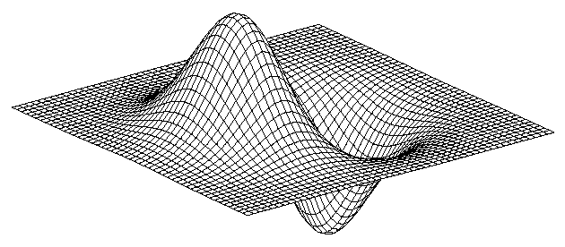
Gaussian derivative kernel 2D
Derivative of Gaussian
x-direction
y-direction

Slide 27
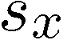
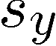
Sobel filter
Common approximation of derivative of Gaussian
Can also be thought of as Prewitt with higher weighting for closer neighbors.
In theory- should give better performance relative to Prewitt since it includes smoothing effect.
In practice- non definitive superiority to Prewitt (3X3 kernel is a rough approximation…).
1 | 0 | -1
2 | 0 | -2
1 | 0 | -1
1 | 2 | 1
0 | 0 | 0
-1 | -2 | -1

Slide 28
Contents
Intro to edges
Basic edge image
Edge thinning
LoG
NMS
Edge mask
Canny edge detector
Other edge related topics
Frequency representation
Unsharp filter

Slide 29
Edge thinning
I have the edge filter result, but I want only one pixel to represent the edge in a binary mask.
How do I find this?

Slide 30
Naïve approach: 2nd derivative
Let’s try to find the zero crossing of the 2nd derivative.
Only single zero crossing- should produce thinner edge

Slide 31
Naïve approach: 2nd derivative
In practice: this approach is very susceptible to noise!

Slide 32
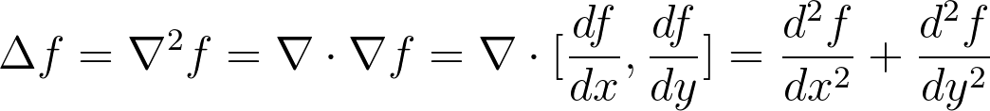
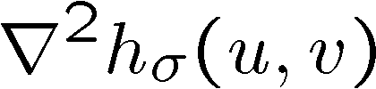
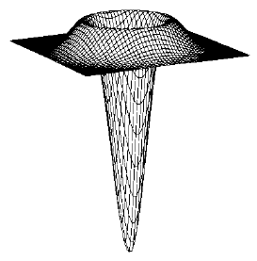
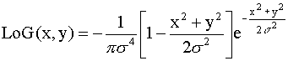
A better approach: LoG
Let’s take the 2nd derivative of the Gaussian (Laplacian of Gaussian: LoG) kernel so smoothing will help with noise reduction:
Laplacian of Gaussian
Notes:
\Delta f = \nabla^2 f = \nabla \cdot \nabla f = \nabla \cdot [\frac{df}{dx},\frac{df}{dy}]=\frac{d^2f}{dx^2}+\frac{d^2f}{dy^2}

Slide 33
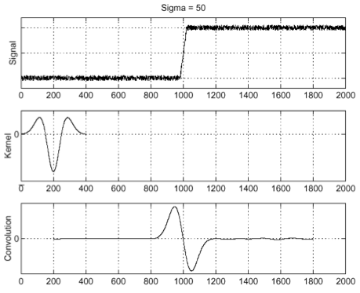
Find edge in noise signal: LoG
Input is noisy step signal; output is zero crossing at the step.
input
Laplacian of Gaussian
output

Slide 34
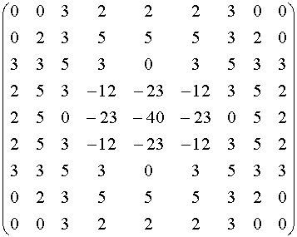
LoG quantization
Can be filter of different sizes:
3X3:
9X9:
0 | 1 | 0
1 | -4 | 1
0 | 1 | 0
1 | 1 | 1
1 | -8 | 1
1 | 1 | 1

Slide 35


DoG
Can also use difference of Gaussians (DoG) to mimic LoG.
Why do we want to do this? Faster computationally (explained here: https://dsp.stackexchange.com/a/37675)

Slide 36


Slide 37



Example: LoG
Absolute magnitude 1st derivative gaussian filter
$$|LoG(x)|$$

Slide 38

Example: LoG
Note: both images are after absolute value.
zero-crossing
peak
$$|LoG(x)|$$
Absolute magnitude 1st derivative gaussian filter

Slide 39
Zero crossing
The new problem arising from the LoG filter is: how to mark the zero crossings?
Answer: no easy algorithm to detect zero crossings.
E.g.: planes with minor noise will also produce zero crossing artifacts.

Slide 40
Contents
Intro to edges
Basic edge image
Edge thinning
LoG
NMS
Edge mask
Canny edge detector
Other edge related topics
Frequency representation
Unsharp filter

Slide 41
Edge thinning
I have the edge filter result, but I want only one pixel to represent the edge in a binary mask.
How do I find this?

Slide 42

Non maximum suppression
NMS
Find the gradient magnitude + orientation of each pixel and search on this 1D line for maximum point.

Slide 43

NMS algorithm
get image gradient magnitude + orientation using 1D 3X3 gradient filter (e.g.: Sobel).
for each pixel $p_{0}$:
Quantize $∢p_{0}$to one of four possibilities: $[0°,45°,90°,135°]$.
In 3X3 neighborhood of $p_{0}$, find two neighbors in quantized gradient orientation $\{p_{1}, p_{2}\}$.
If $\left|\left|p_{0}\right|\right|<\left|\left|p_{1}\right|\right| or \left|\left|p_{0}\right|\right|<\left|\left|p_{2}\right|\right|:$
$\left|\left|p_{0}\right|\right|←0$

Slide 44


NMS results
Before NMS
After NMS

Slide 45
Contents
Intro to edges
Basic edge image
Edge thinning
LoG
NMS
Edge mask
Canny edge detector
Other edge related topics
Frequency representation
Unsharp filter

Slide 46
Edge mask
How do we transform this integer image to a binary mask of where there is/ isn’t an edge?

Slide 47
First try: single threshold edge mask
Mask == binary image.
Possible 1st solution- thresholding:
Choose an TH edge value, above which the pixel mask is 1, 0 otherwise.
The value can be a constant or percentile of the maximum edge value exists in the image.
Low TH: will get extra edges, but also input noise.
High TH: can miss lower valued edge pixels, less noise.
How can we difference between low value edge pixels and noise?

Slide 48


Hysteresis motivation
Weak edges are usually neighbors of strong edges, while noise can be at any pixel.
Usually “neighbors” means 3X3 square of adjacent pixels.
If we know that a neighbor of a weak edge is a strong edge, then the weak edge is a strong edge!
Schmitt trigger hysteresis example plot

Slide 49

hysteresis
Choose two thresholds: $\{TH_{h},TH_{l}|TH_{h}>TH_{l}\}$
For each pixel $p_{i}$:
If $p_{i}≥TH_{h}:$
$p_{i}←1$
elif ${TH_{l}≤p}_{i}<TH_{h}:$ $p_{i}←weak_edge_pixel$
Else: //$p_{i}<TH_{l}$ $p_{i}←0$
While $weak_edge_pixels$ that are neighbors of $1$ exists:
for each$weak_edge_pixe{l_p}_{i}$:
If $weak_edge_pixe{l_p}_{i}$ neighbor of $1$: $weak_edge_pixe{l_p}_{i}←1$
All remaining $weak_edge_pixels←0$

Slide 50
Contents
Intro to edges
Basic edge image
Edge thinning
LoG
NMS
Edge mask
Canny edge detector
Other edge related topics
Frequency representation
Unsharp filter

Slide 51
Canny edge detector
Canny edge detector is one of the most known and used CV algorithms, still highly used even today (developed in 1986, cited 33000 times until 2019):
Gaussian filter
Find image gradient magnitude and orientation
NMS
Hysteresis

Slide 52

Example output

Slide 53





Different Gaussians
Stronger smoothing will cause only “large-scale” gradients to remain (more on scaling- later in class).
original
Canny with
Canny with

Slide 54
Important note: tradeoffs
It’s a common misconception in CV to think that one algorithm is always better than another.
In CV, algorithms are highly dependent in the given environment in which they are executed. Each environment can vary in:
Noise.
Needed computation efficiency.
Overall problem variance.
Etc…
CV is the land Of
tradeoffs

Slide 55
Contents
Intro to edges
Basic edge image
Edge thinning
LoG
NMS
Edge mask
Canny edge detector
Other edge related topics
Frequency representation
Unsharp filter

Slide 56

HP filter
Higher frequencies represents the edges of images.
Removing the lower frequencies of an image will result in edge image!

Slide 57

Edge filters- frequency representation

Slide 58

Why prewitt has waves?
Recalling the mean filter – we can say that prewitt is like two side by side rectangles.
Sobel is like two gaussians side by side!

Slide 59
Contents
Intro to edges
Basic edge image
Edge thinning
LoG
NMS
Edge mask
Canny edge detector
Other edge related topics
Frequency representation
Unsharp filter

Slide 60


Image sharpening
Obtain the high frequencies magnitude image.
Enhance the edges (e.g. by multiplying with a constant>1).
Add the enhanced edges back to the original image.
Or- one liner:
Notes:
f_{sharpen} = f + \gamma \cdot ||\triangledown f||

Slide 61

Unsharp filter
The former can also be done with only low pass filtering!
This was also the way that photographers enhanced edges before CV (dates to the 1930s). More on this topic here: https://en.wikipedia.org/wiki/Unsharp_masking#Photographic_darkroom_unsharp_masking
Notes:
f_{unsharp} = f + \gamma (f- h_{blur}*f)

